Slide 1
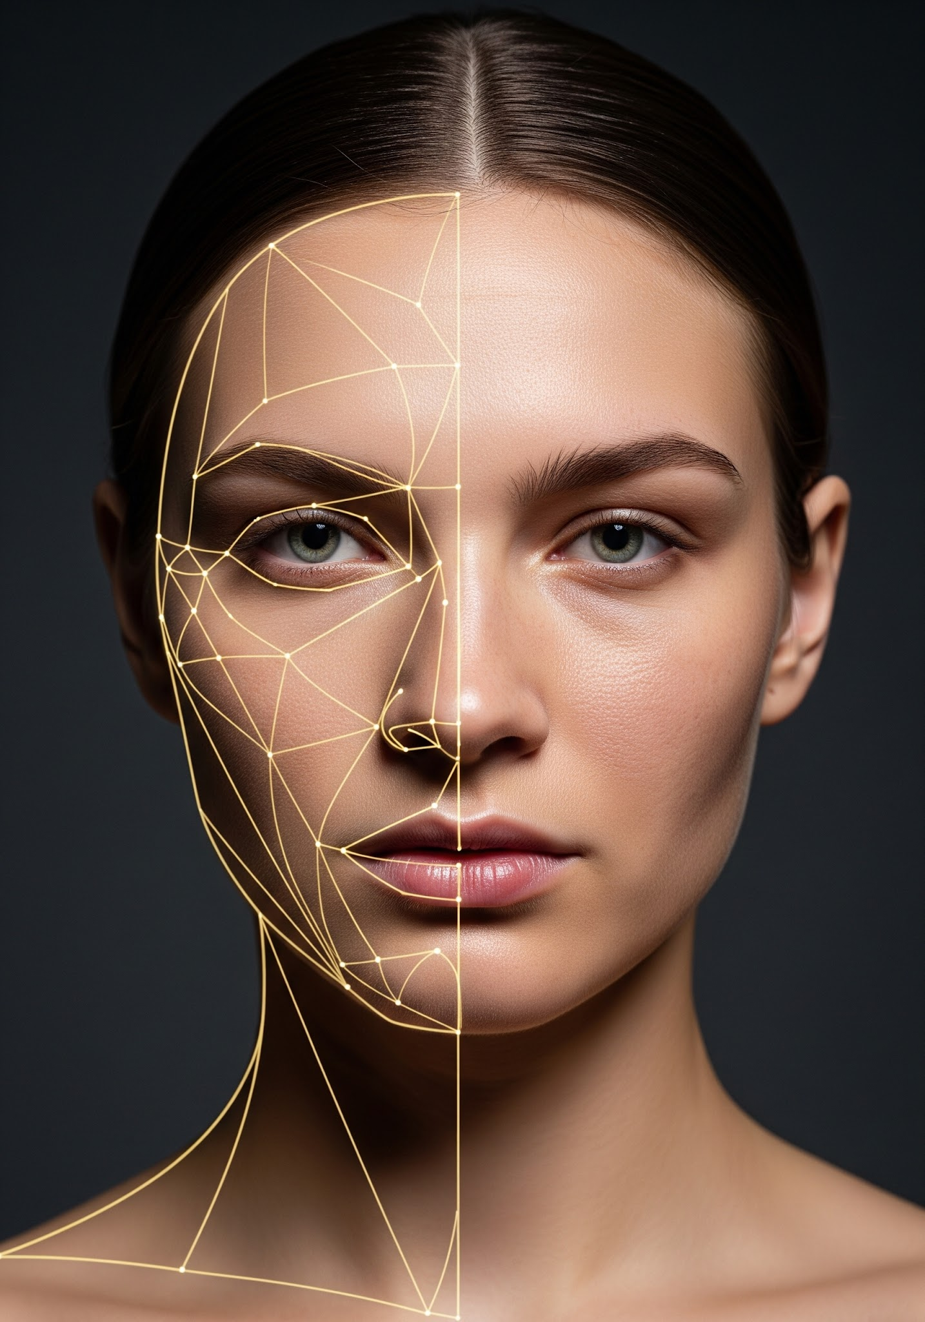
Does Beauty Lie in Symmetry or in the Eye of the Beholder?
Disentangling Geometry and Texture using Adaptive Gated Networks
EE655 - CVDL PROJECT
IIT KANPUR
Multi-Modal Gated Networks for Aesthetic Face Scoring

Slide 2
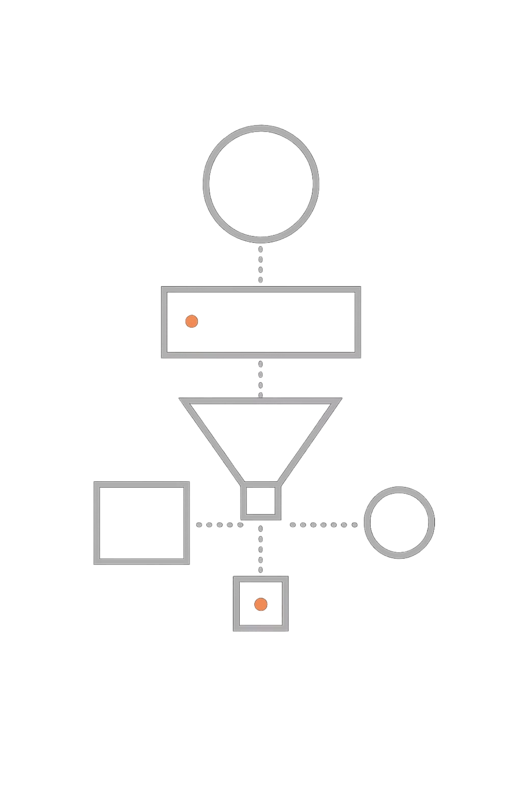
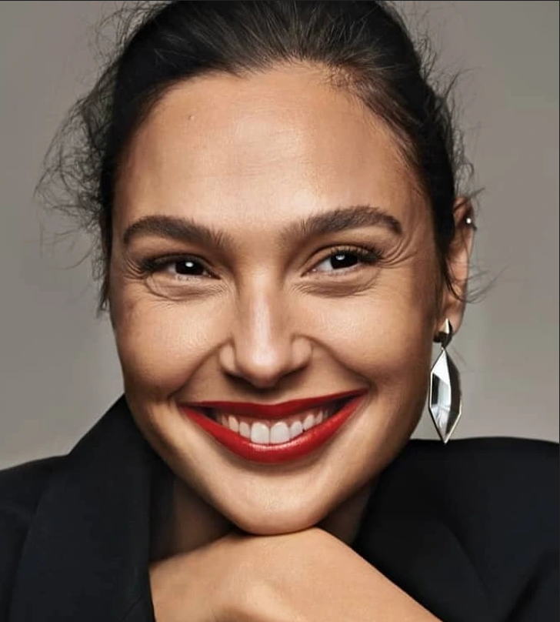
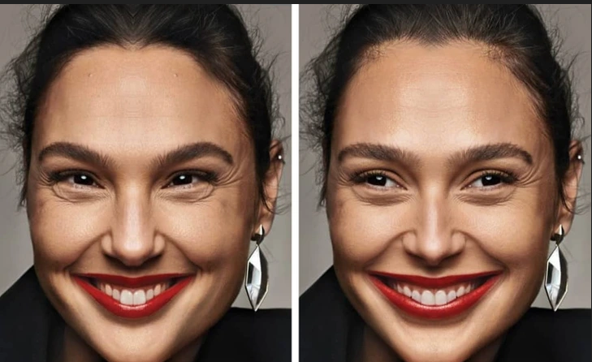

Two Competing Theories of Beauty
The Geometry View
The Texture View
Facial attractiveness is governed by symmetry and golden ratios — measurable distances between eyes, nose, and lips. Plastic surgeons still rely on these landmark coordinates.
Beauty is mostly surface-level — skin quality, lighting, makeup, and expression. These cues are perceptual, not geometric.
Our Question
Which factor truly governs perceived attractiveness? Can we disentangle the two in a principled way?
But: perfectly symmetric faces often look unnatural.

Slide 3

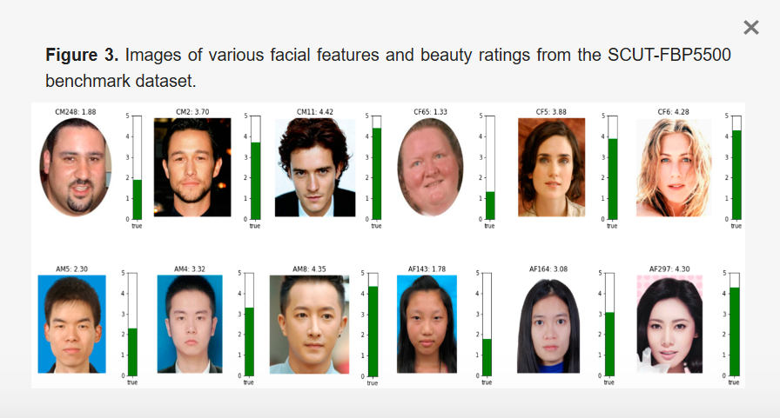
Previous Work / Datasets & Experimental Strategy
SCUT-FBP5500
5,500 frontal faces, each rated by 60 annotators on a 1–5 attractiveness scale. Ratings are averaged — introducing inherent subjectivity.
It became a standard benchmark dataset in FBP research.
Authors: Lingyu Liang, Luojun Lin, Lianwen Jin, Duorui Xie, Mengru Li
Three-Pronged Approach
01
02
03
Texture-Only Model
Geometry-Only Models
Adaptive Gated Fusion
ResNet-18 on raw pixels — upper bound of explainable variance.
2D & 3D landmarks — pure structural information.
Network learns per-face when to trust texture vs. geometry.

Slide 4

Model Architectures at a Glance
Model
Input
Architecture
M1 — Texture
Image 224×224
ResNet-18 pretrained + regression head
M2 — 2D Geo
468 landmarks → 1,404 distances
MLP [256, 128] → 1
M3 — 3D Geo
3D landmarks + Procrustes alignment
MLP [256, 128] → 1
M4 — Gated Fusion
Image + 3D landmarks
ResNet-18 + MLP + Gating (α, β)
M5–M8
Various
ViT, Cross-Attention Transformers
Key novelty in M4: ŷ = α · y_img + β · y_land, where α + β = 1, and both α, β are learned dynamically from image features per face.

Slide 5
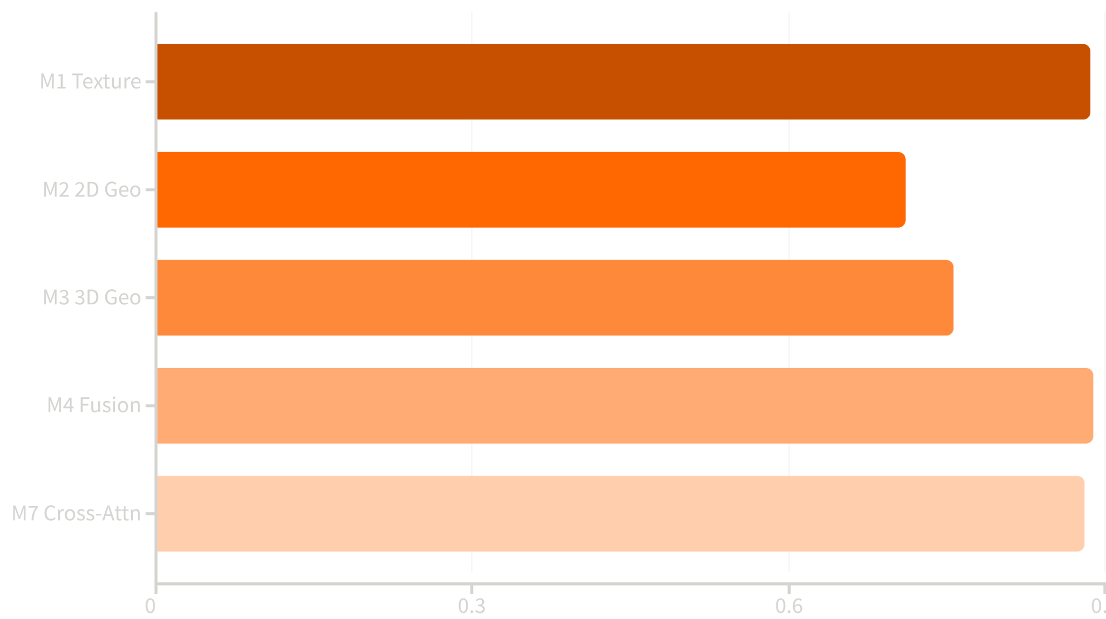

Key Results — Correlation with Human Ratings
The Central Surprise
Texture alone (M1) achieves ρ = 0.886, explaining ~88% of variance in human ratings. Geometry-only models peak at just ρ = 0.757.
The gated fusion (M4) improves over M1 by only +0.003 — a statistically marginal gain.
Adding structure to a strong texture model yields diminishing returns.

Slide 6
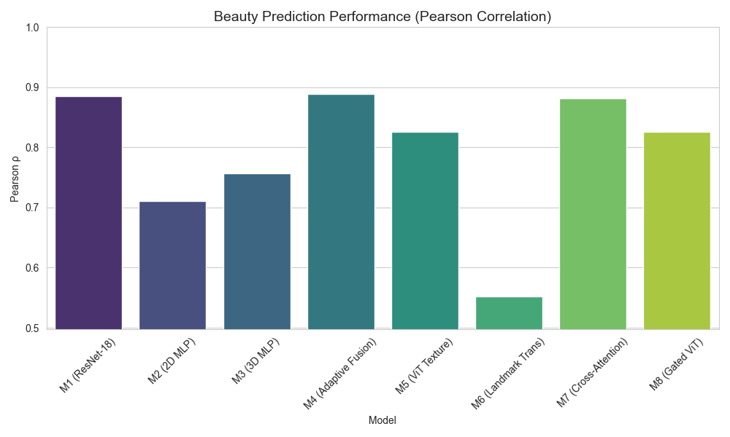
Model Comparison: Image vs Landmark-Based Learning
PERFORMANCE GAP
corr(M1, GT) = 0.89
corr(M3, GT) = 0.76
Image-based learning significantly outperforms landmarks alone.
GEOMETRY EMBEDDING
corr(M1, M3) ≈ corr(M3, GT)
Geometric information is already naturally embedded within the image model (M1).
Figure: Beauty Prediction Performance (Pearson Correlation)
Key Insights
foundation
Geometric Foundations
Landmarks capture the essential geometric structure, providing a baseline for facial analysis.
visibility
The "Visual Plus"
Image models learn geometry PLUS visual cues like texture, lighting, and fine expressions.
trending_up
Appearance Dominance
Appearance features provide the most significant gain, accounting for the 13-point correlation lead.

Slide 7

What the Gating Network Reveals
62%
38%
25%
Texture Dominant
Geometry Engaged
Pure Geometry
β < 0.5 — geometry contributes less than 50%, often near zero. Texture completely dominates the prediction.
β > 0.5 — geometry is the primary predictor. Even so, texture retains α ≈ 0.3–0.4 contribution.
25% face relies on geometry alone. Texture is never fully suppressed — even in 22 % geometry-dominant cases.

Slide 8
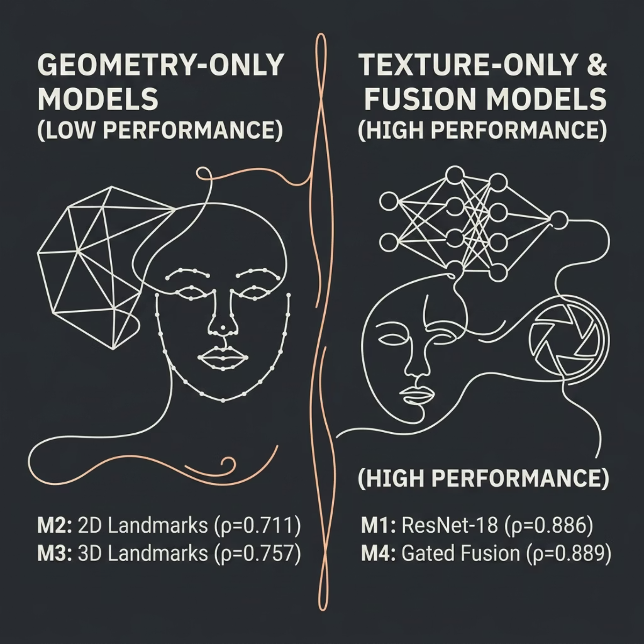


The Surprising Finding — Symmetry Is a Weak Predictor
What This Tells Us
If golden ratios or symmetry were the primary drivers of beauty perception, geometry models would approach texture performance. They don't — they fall 13 correlation points short.
Most of what humans call "beauty" appears to be surface-level: skin, lighting, expression, and grooming — not only hidden mathematical proportions.
But wait — could the dataset itself be the confound?

Slide 9

Data Biases — Why We Cannot Be Certain
Subjectivity in Labels
Camera Confounds
Expression & Makeup
Ratings are averages over ~60 annotators. Cultural, religious, and individual biases remain embedded in the ground truth.
Lighting, resolution, and pose variation affect texture far more than geometry. The model may have learned camera artifacts, not true aesthetics.
Objectively attractive faces scored low due to poor image quality or unusual expression — introducing label noise that benefits texture models.
The model may encode photographic biases, not universal aesthetic principles. Results should be interpreted with this caveat explicitly in mind.

Slide 10
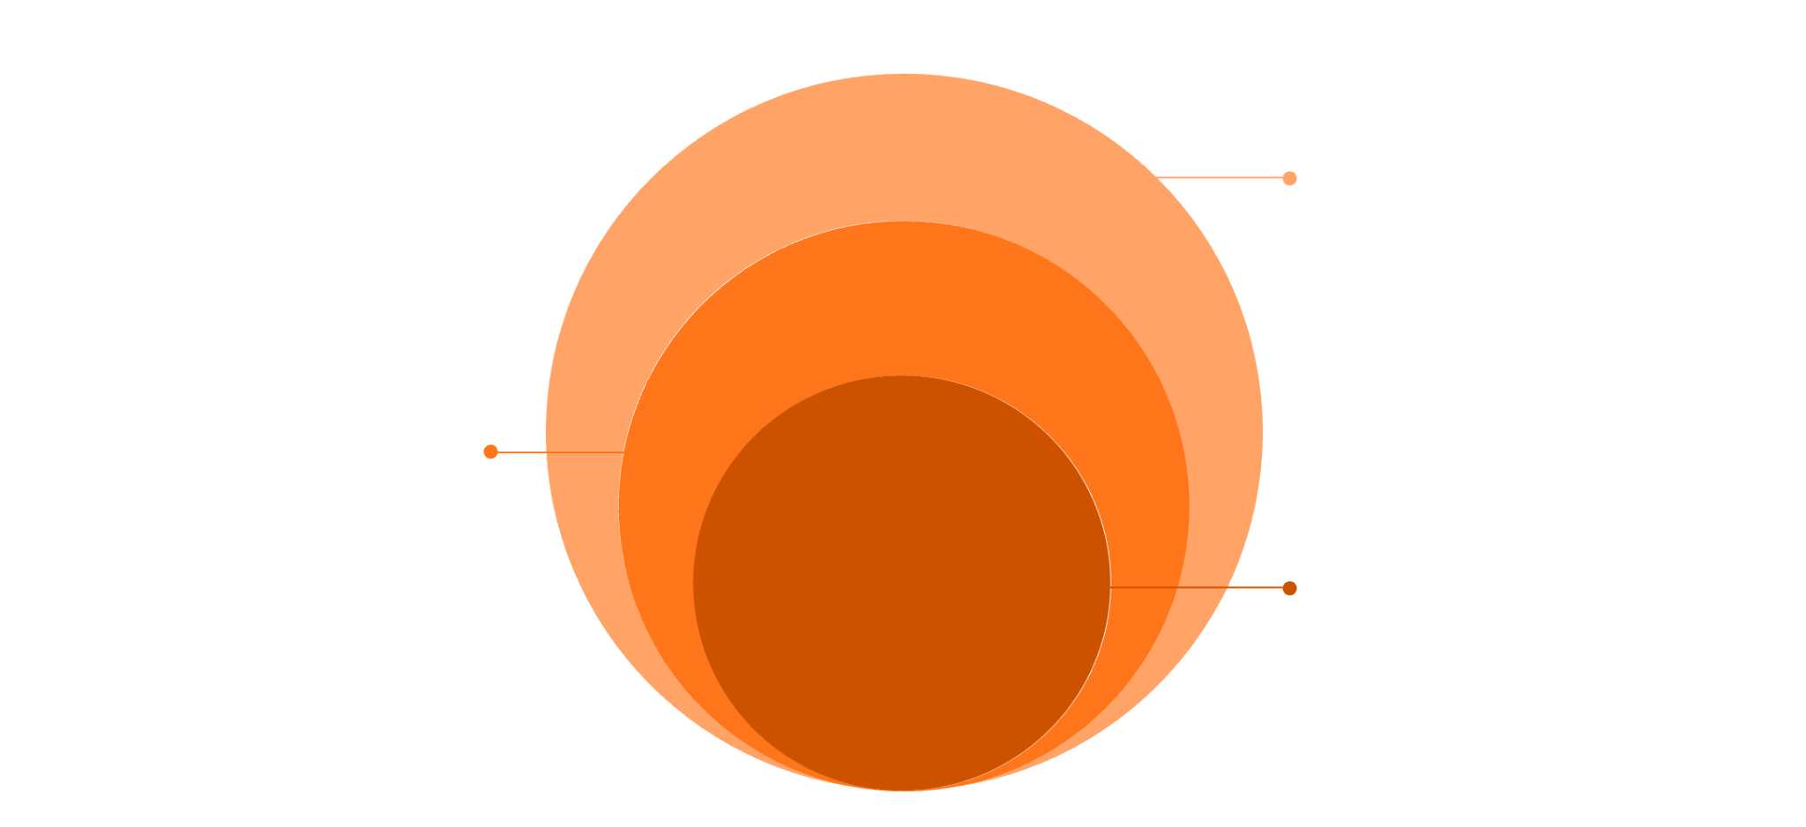
Reconciling the Contradiction
Our Interpretation
True Aesthetics Unknown
If beauty were purely symmetry-based, 3D landmarks would match image performance — they don't.
If beauty were purely texture-based, gating would never activate geometry — but it does in 20–38% of faces.
Geometry provides complementary signals when texture is ambiguous: bad lighting, extreme expression, unusual makeup.
The "golden ratio" effect is likely a secondary, not primary, factor in human beauty perception.
Dataset biases remain unresolved
Geometry Complements
Active in 20–38% of ambiguous faces
Texture Explains Most
ρ=0.886; ~88% variance explained
The scientific question remains open — but the model provides an interpretable, data-driven lens into the geometry-texture trade-off.

Slide 11


Take-Home Messages
1
Texture dominates
Skin, lighting, and grooming explain ~88% of variance. Geometric ratios alone are insufficient.
2
Adaptive gating works
The network successfully identifies the ~20–38% of faces where geometry provides meaningful complementary signal.
3
Biases demand caution
Camera conditions and cultural annotations may inflate texture's apparent role. Controlled data collection is the critical next step.
4
Future directions
Expression normalization, demographically balanced datasets, and cross-cultural replication studies.
Code & Models: GitHub link | Key Reference: SCUT-FBP5500, Liang et al. 2018

Slide 12
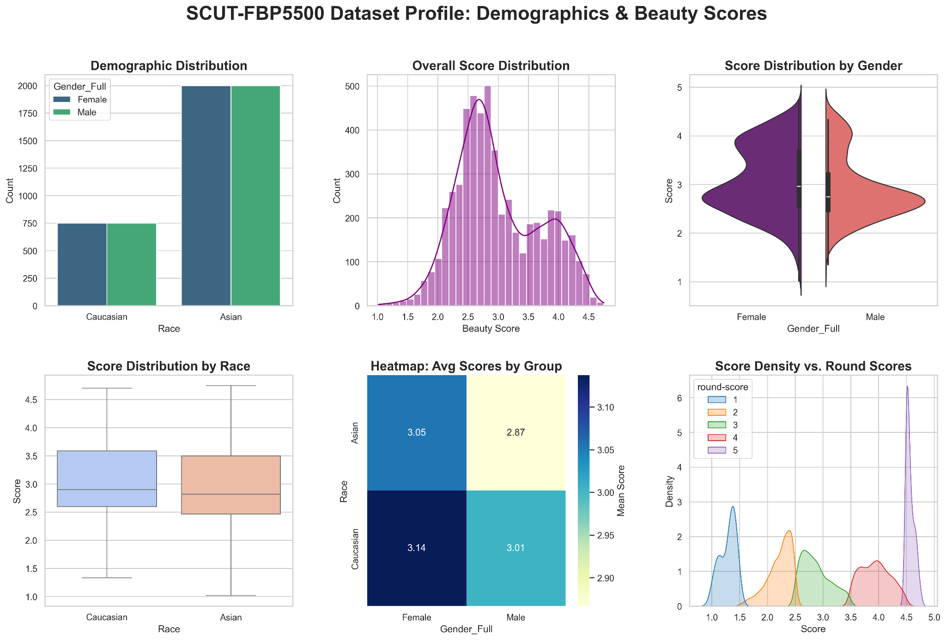
Demographic Bias
Analysis
Ethnic Imbalance
The dataset is heavily skewed toward Asian samples (2.7:1 ratio), potentially leading to sampling bias.
Gender Scoring Variance
Human raters assigned a wider range of scores to females, suggesting the "beauty standard" for females is more diverse or complex to model compared to more tightly clustered male scores.
High-Level Bias
Caucasian Females have the highest average rating (3.14), while Asian Males have the lowest (2.87).

Slide 13
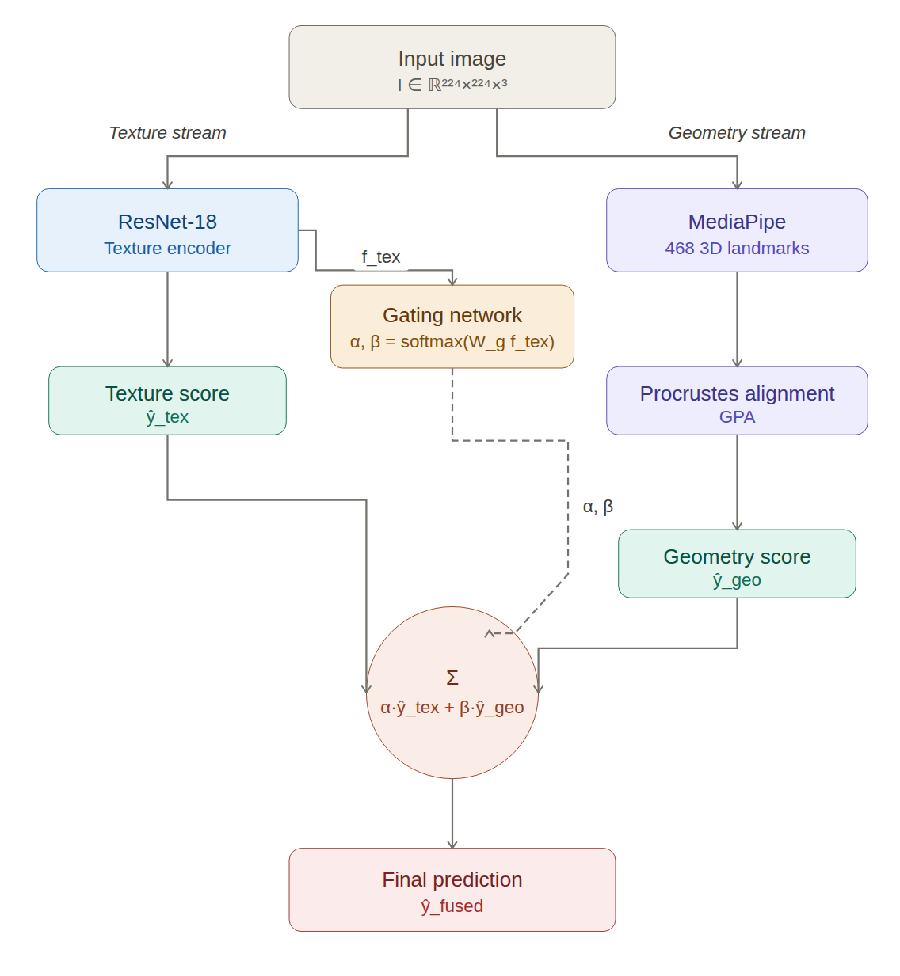
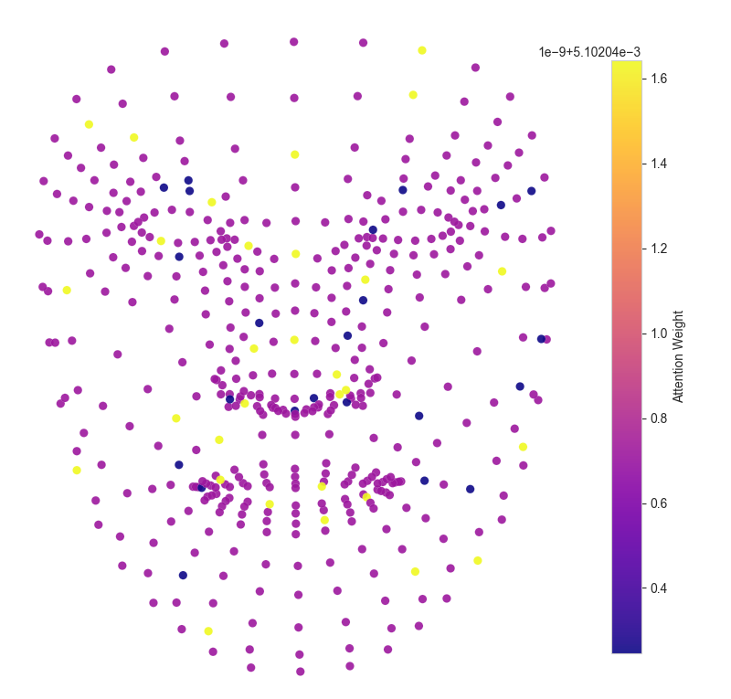
Architecture & Key Figures
Figure 1: Spatial Attention Map
Figure 2: Gated Model (M4) Architecture

